Slide 1
Disparities in Ischemic Heart Disease in
Rhode Island state US
Research Area :
Working on CDC Wonder Mortality Data (Center of Disease Control and Prevention)
Year 2012-17 https://wonder.cdc.gov/ucd-icd10.html
Year 2018-23 https://wonder.cdc.gov/ucd-icd10-expanded.html
Examining deaths from ischemic heart disease (ICD-10 codes: I20-I25)
Study area : Rhode Island state US
Research Objective : To analyze trends and patterns in ischemic heart disease data and communicate insights that support the development of evidence-based interventions.

Slide 2
Ischemic Heart Disease
What is ischemia?
Ischemia when blood flow and oxygen is reduced in a part of the body. Cardiac ischemia is decreased blood flow and oxygen to the heart muscle.
What is ischemic heart disease?
Ischemic heart disease is heart damage caused by narrowed heart arteries. This is also called coronary artery disease and coronary heart disease. When arteries narrow, less blood and oxygen reach the heart muscle. This can lead to heart attack.
Major Causes of IHD:
Coronary Heart Disease (CHD) – plaque buildup in major coronary arteries
Coronary Artery Spasm – temporary tightening of coronary arteries
Microvascular Disease – dysfunction of small coronary vessels
Aortic Valve Disease (e.g., Aortic Stenosis) – restricts blood flow to coronary arteries
Severe Anemia – reduces oxygen delivery to heart muscle
Low Blood Pressure (Hypotension) – decreases coronary perfusion
Coronary Embolism – clot blocks a coronary artery
Congenital Coronary Anomalies – structural abnormalities from birth
https://www.heart.org/en/health-topics/heart-attack/about-heart-attacks/silent-ischemia-and-ischemic-heart-disease

Slide 3
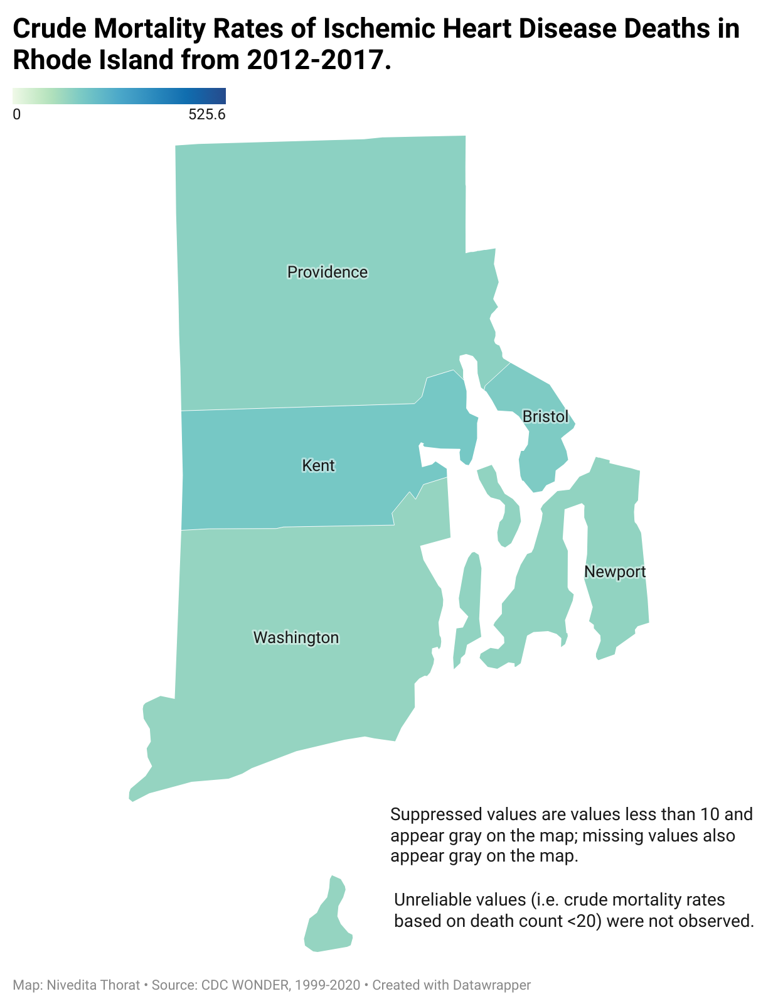

Primary County of Concern
The Choropleth map highlights KENT as the county with the highest crude mortality rate for both periods. That is the significant reason to choose KENT County for further investigation.

Slide 4
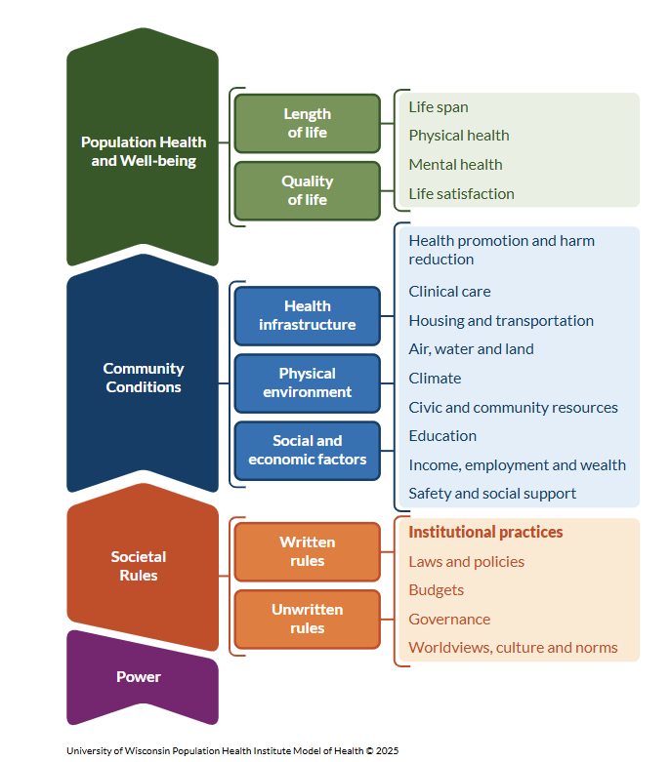
County Health Ranking Model: Risk Factors in Kent County
Adult smoking rates (16–17%) are comparable to state levels but still represent a persistent risk factor for cardiovascular diseases.
Excessive drinking (19–20%) exceeds national averages in 2017 and 2018, compounding risks for heart disease and related health issues.
Adult obesity (29–32%) is steadily rising, aligning with national trends and significantly impacting heart disease prevalence.
Insufficient sleep (35–37%) continues to be widespread, further elevating cardiovascular and metabolic health risks.
https://www.countyhealthrankings.org/what-impacts-health/model-of-health

Slide 5
Key Factors Contributing to High Crude Mortality Rate
Lifestyle Risk Factors Worsening in Kent:
Between 2017 and 2018, adult smoking, excessive drinking, adult obesity, and insufficient sleep all increased in Kent County, all of which are known contributors to a higher risk of ischemic heart disease.
https://www.countyhealthrankings.org/health-data

Slide 6
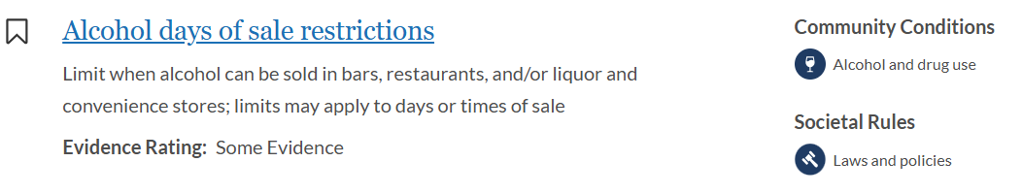
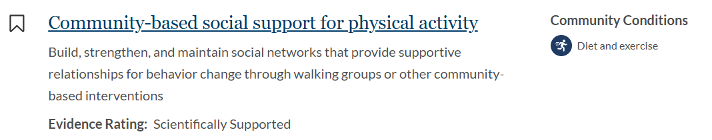
Research Objective: Evidence based Intervention
🔹 Expand Access to Exercise – Develop community fitness programs, walking trails, and subsidized gym memberships to address rising obesity (32%) and insufficient sleep (37%) contributing to heart disease risk.
🔹 Implement Smoking and Alcohol Cessation Programs – Offer free tobacco and alcohol cessation support, nicotine replacement therapies, and awareness campaigns to reduce the growing rates of adult smoking (17%) and excessive drinking (20%).
🔹 Enhance Sleep Health Initiatives – Launch public health campaigns promoting healthy sleep habits and stress management programs to address the high prevalence of insufficient sleep (37%) linked to cardiovascular risk.
https://www.countyhealthrankings.org/what-impacts-health/model-of-health

Slide 7
Whom to reach out ?
🔹 Kent County Health Department – For organizing and coordinating public health programs like fitness, smoking cessation, nutrition, and sleep health campaigns.
Kent County Health Department
700 Fuller Ave NE
Grand Rapids, MI 49503
(https://www.kentcountymi.gov/1422/Health-Department)
🔹 Community Centers and YMCA Locations – To create or expand affordable fitness and wellness programs locally.
900 Centerville Rd Warwick, RI 02886
KENT COUNTY YMCA

Slide 8

Thank You!

